Slide 1
Battle for Neighborhood
Where to open the most popular Cocktail bar in the town?

Slide 2
Introduction
Cocktail Bar will not serve any food.
Selecting cocktail bar location in Delhi based on neighborhood data
Following parameters were taken into consideration while selection –
Maximum restaurants in nearby
Minimum bars in nearby
Availability of public transport (Metro-station) in nearby location

Slide 3
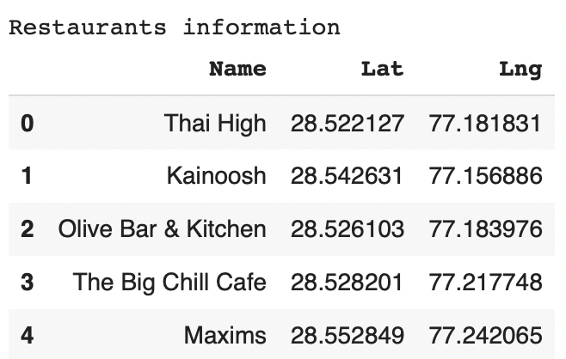
Data Selection
Following Foursquare API data was utilized for the study –
Restaurants data in Delhi (Name, Longitude, Latitude)(Top 100)
Bars data in Delhi (Name, Longitude, Latitude)(Top 100)
Delhi Metro-Station data(Total 54 data-points)(Name, Longitude, Latitude)

Slide 4
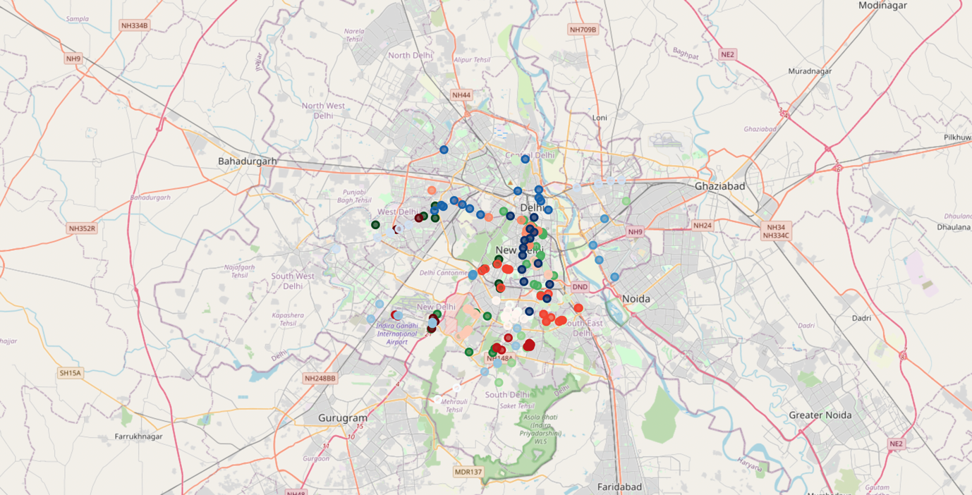
Methodology
Kmeans square clustering considering k=11, as there are 11 districts in Delhi data was clustered and superimposed to Delhi Map using folium
Red – Bars
Blue – Metro
Green - Restaurants

Slide 5
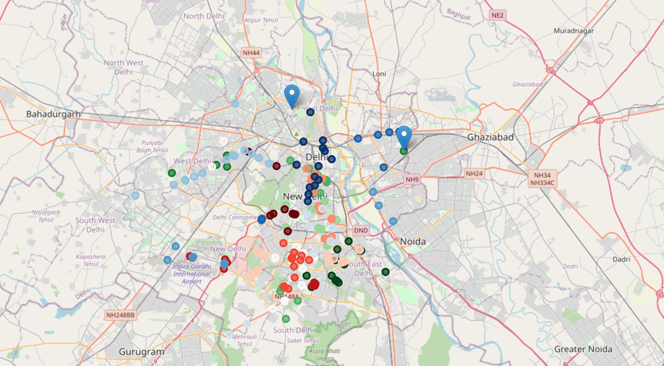
Results
Based on the the clustered Map there were few location where restaurants density was higher with very few bars. As per our requirement two locations were marked as suitable for opening cocktail bar -

Slide 6
Conclusion
Although as per study it can be concluded that there are two suitable location for opening a cocktail bar. However, only top 100 bars and restaurants were selected for this study for conclusion more in-depth rigorous study is required while taking all available data into the consideration.

